Slide 1
GREATER BRIDGEPORT MEDICAL ASSOCIATION
WELCOME TO THE 153rd ANNUAL MEETING AND THE
13th ANNUAL AWARDS BANQUET AND
HOSPITAL MEDICAL STAFF MEET AND GREET

Slide 2
GREATER BRIDGEPORT MEDICAL ASSOCIATION
Thank you to the SPONSORS FOR THEIR GENEROUS SUPPORT

Slide 3
H HIGH SCHOOL SCHOLARSHIPS AWARDED BY GBMA
YEAR | SCHOLARSHIPS AWARDED | AMOUNT
2006 | 5 scholarships | $3,000
2007 | 5 scholarships | $3,750
2008 | 5 scholarships | $6,000
2009 | 5 scholarships | $6,000
2010 | 5 scholarships | $7,500
2011 | 5 scholarships | $7,500
2012 | 5 scholarships | $7,500
2013 | 5 scholarships | $7,500
2014 | 5 scholarships | $7,500
2015 | 6 scholarships | $7,500
2016 | 6 scholarships | $7,500
2017 | 4 scholarships | $5,500
2018 | 5 scholarships | $6,500
2019 | 5 scholarships | $11,000
TOTALS | 71 SCHOLARSHIPS | $94,250

Slide 4
GREATER BRIDGEPORT MEDICAL ASSOCIATION
HIGH SCHOOL SCHOLARSHIP RECIPIENTS – 2019
NAME HIGH SCHOOL COLLEGE STUDY
Kaylin Guillaume | Central – Magnet High School | Sacred Heart University | Biology & Psychology
Christine Jimenez | Central High School | Undecided | Nursing
Pilar Montes | Bullard Havens High School | Sacred Heart University | Occupational Therapy
Berveline Pierre | Warren Harding High School | Berkely College | Nursing
Madaha Tagnidoung | Bassick High School | WCSU | Nursing

Slide 5
GREATER BRIDGEPORT MEDICAL ASSOCIATION
Congratulations
The Grand Winner of the 2019
Robert D. Scinto Scholarship Award
Berveline Pierre
Warren Harding High School

Slide 6
NURSING SCHOLARSHIPS AWARDED BY GBMA
YEAR | SCHOLARSHIPS AWARDED | AMOUNT
2006 | 1 scholarship | $ 250
2007 | 2 scholarships | $1,000
2008 | 2 scholarships | $1,000
2009 | 2 scholarships | $1,000
2010 | 2 scholarships | $1,000
2011 | 2 scholarships | $1,000
2012 | 2 scholarships | $1,000
2013 | 2 scholarships | $1,000
2014 | 2 scholarships | $1,000
2015 | 2 scholarships | $1,000
2016 | 2 scholarships | $1,000
2017 | 2 scholarships | $1,000
2018 | 3 scholarships | $1,000
2019 | 2 scholarships | $1,000
TOTALS 28 scholarships $13,250

Slide 7
GREATER BRIDGEPORT MEDICAL ASSOCIATION
NURSING AWARD RECIPIENTS - 2019
YNHH BRIDGEPORT HOSPITAL
AUDREY SEIGLE, RN
Introduction by: Ryan O’Connell, MD
ST. VINCENT’S MEDICAL CENTER
BETH HARE, RN
Introduction by: Milton Armm, MD

Slide 8
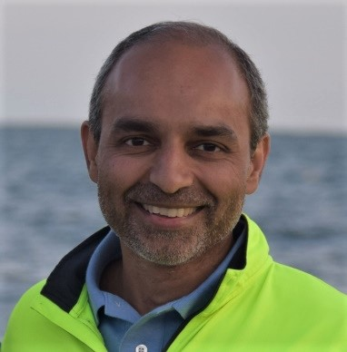
KEYNOTE SPEAKER
Nandip Kothari
CEO
The Use of Artificial Intelligence in Medicine

Slide 9
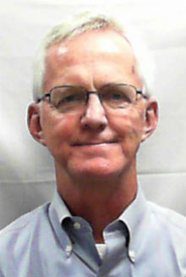
Physician of the Year Award
Michael Smith, MD
Introduction by Michael Ivy, MD

Slide 10
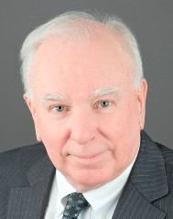
Physician of the Year Award
Joseph Andrews, Jr., MD
Introduction by Frank Scifo, MD

Slide 11
Donations Were Made to the Following Organizations in 2018:
AmeriCares Free Clinics
Bridgeport Child Advocacy Coalition
Bridgeport Hospital - 37th Annual Kaulbach Memorial Golf Classic
Bridgeport Rescue Mission
Connecticut Food Bank
Council of Churches of Greater Bridgeport
Goodwill Western and Northern Connecticut
Homes for the Brave
The Kennedy Center
Mercy Learning Center
Operation Hope
St. Vincent’s Medical Center - Dispensary of Hope

Slide 12
YEAR | COMMUNITY OUTREACH | AMOUNT
2006 | Donations (multiple organizations) | $ 500
2007 | Donations (multiple organizations) | $ 625
2008 | Donations (multiple organizations) | $ 1,040
2009 | Donations (multiple organizations) | $ 2,200
2010 | Donations (multiple organizations) | $ 675
2011 | Donations (multiple organizations) | $ 625
2012 | Donations (multiple organizations) | $ 750
2013 | Donations (multiple organizations) | $ 1,325
2014 | Donations (multiple organizations) | $ 1,525
2015 | Donations (multiple organizations) | $ 1,325
2016 | Donations (multiple organizations) | $ 1,325
2017 | Donations (multiple organizations) | $ 1,325
2018 | Donations (multiple organizations) | $ 1,325
2019 TOTAL | Donations (multiple organizations) | $ 1,325 $15,890

